Slide 1




Lip-Reading Recognition for Deaf and Dumb using Machine Learning

Slide 2

Introduction
Lip Reading is a task to infer the speech content in a video by using only the visual information, especially the lip movements. It is a process of extracting speech by watching lip movements of a speaker in the absence of sound.
It is a technology based on machine vision and Natural Language Processing and has wide range of applications.
This project verifies the use of machine learning by applying deep learning and neural networks to devise an automated lip-reading system.

Slide 3
Design Methodology
The existing Lip-reading system emphasizes LipNet, it is a neural network architecture for lipreading that maps variable-length sequences of video frames to text sequences, and is trained end-to-end. In this section, we describe LipNet’s building blocks and architecture
LipNet architecture. A sequence of T frames is used as input, and is processed by 3 layers of STCNN, each followed by a spatial max-pooling layer. The features extracted are processed by 2 Bi-GRUs; each time-step of the GRU output is processed by a linear layer and a softmax. This end-to-end model is trained with CTC.
SPATIOTEMPORAL CONVOLUTIONS:
Convolutional neural networks (CNNs), containing stacked convolutions operating spatially over an image, have been instrumental in advancing performance in computer visions tasks such as object recognition that receive an image as input

Slide 4
GATED RECURRENT UNIT:
Gated Recurrent Unit (GRU) is a type of recurrent neural network (RNN) that improves upon earlier RNNs by adding cells and gates for propagating information over more timesteps and learning to control this information flow. It is similar to the Long Short-Term Memory (LSTM) RNN.
CONNECTIONIST TEMPORAL CLASSIFICATION:
The connectionist temporal classification (CTC) loss (Graves et al., 2006) is widely used in modern speech recognition it is designed for tasks where we need alignment between sequences, but where that alignment is difficult.

Slide 5
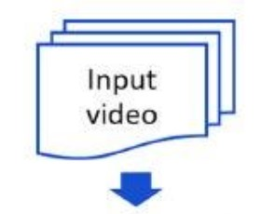
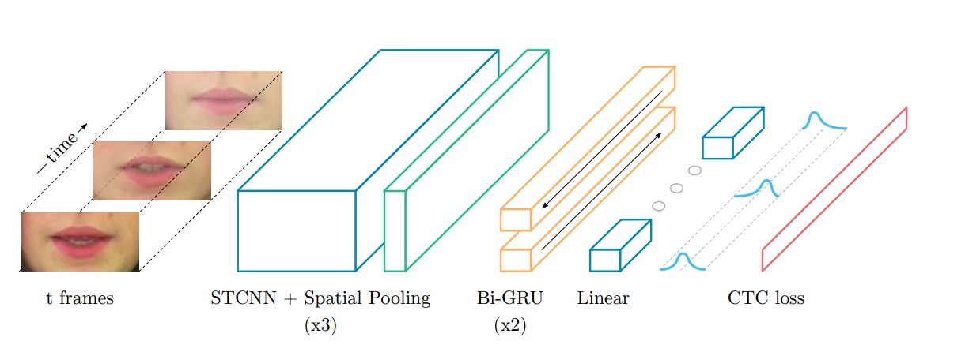
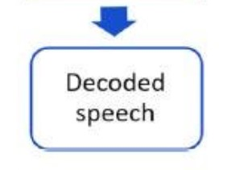

Slide 6
Figure illustrates with the Input video it then pre-processes the video into frames, it then gets passed to the LipNet architecture which starts with, 3×(spatiotemporal convolutions, channel-wise dropout, spatial max-pooling).
Subsequently, the features extracted are followed by two Bi-GRUs. The Bi-GRUs are crucial for efficient further aggregation of the STCNN output.
Finally, a linear transformation is applied at each time-step, followed by a softmax over the vocabulary augmented with the CTC blank, and then the CTC loss. All layers use rectified linear unit(ReLU) activation functions.

Slide 7
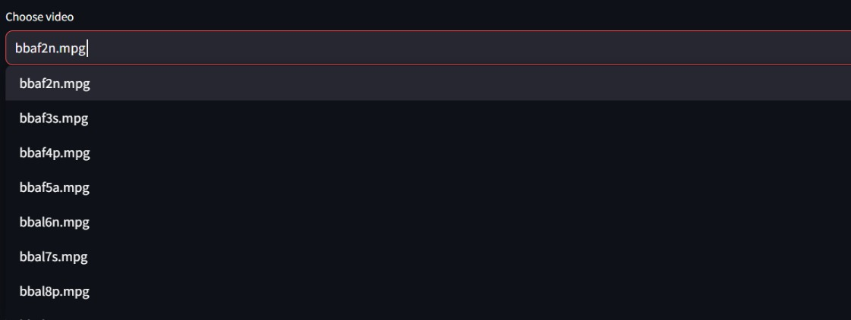
Module demonstration
Step 1 :- Choose a Video from the given Dataset.

Slide 8
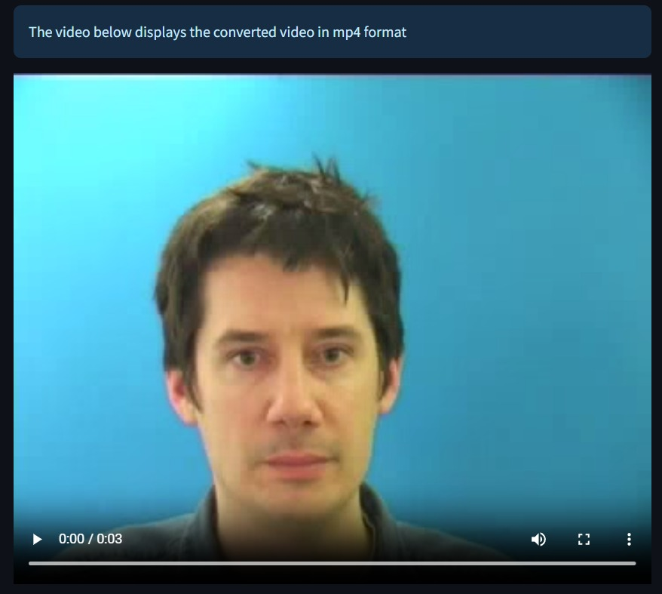
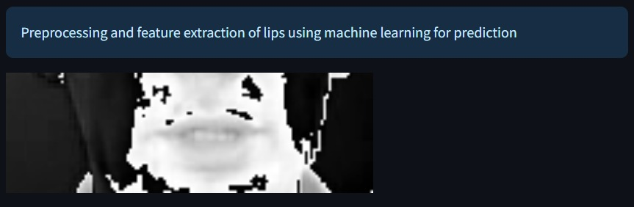
Step 2 :- The Selected video will be displayed on the web application.
Step 3 :- Preprocessing and Feature Extraction of lips using machine learning for prediction.

Slide 9
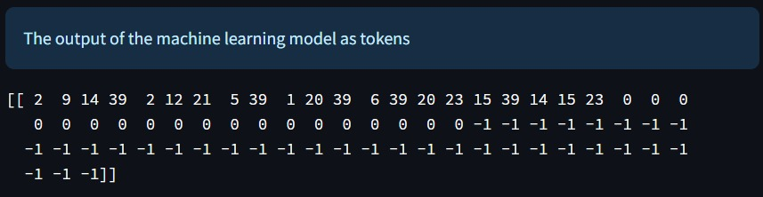
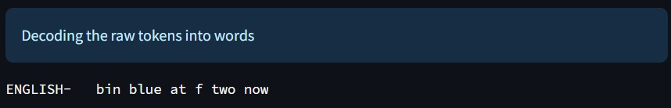
Step 4 :- The Output of the machine learning model as tokens.
Step 5 :- Decoding the raw tokens into words.

Slide 10
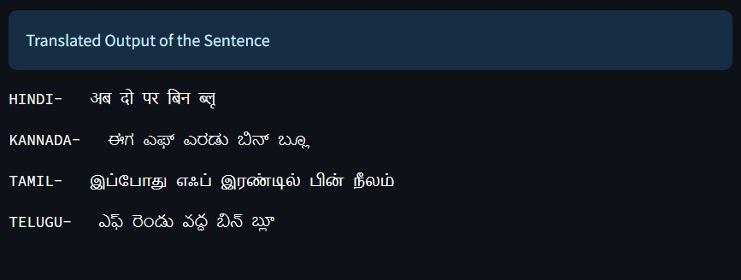
Step 6 :- Translated languages from the given output sentence.

Slide 11
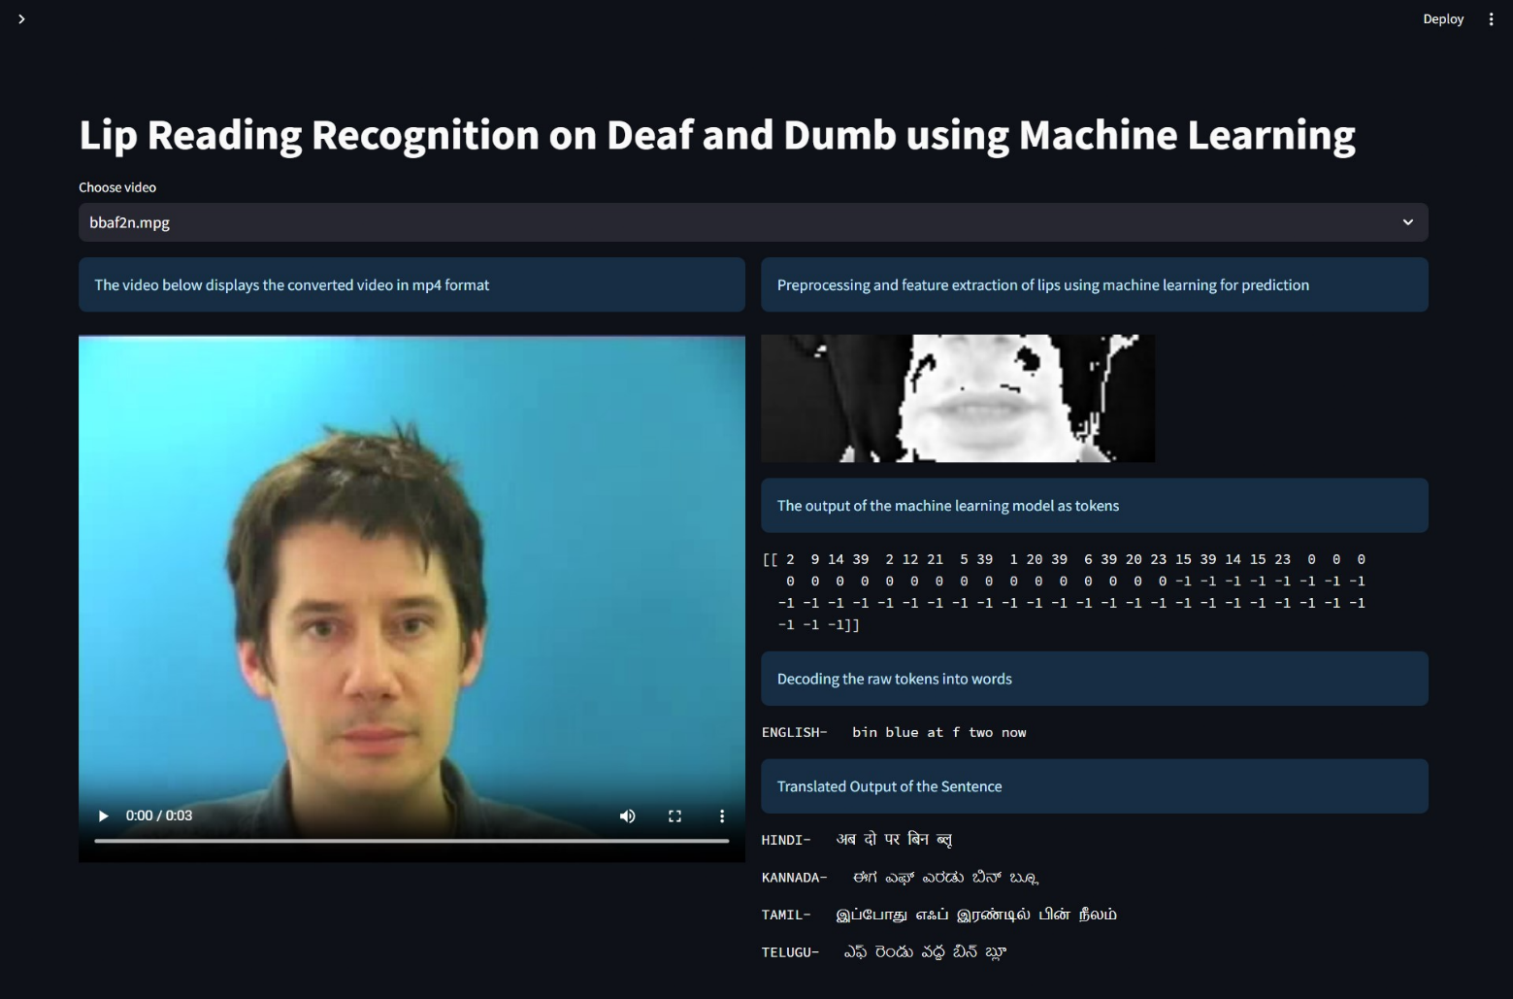
Output/Result

Slide 12
Future Scope
For our future scope, we would like to implement our Lip Reading project on a real time based dataset, for which we have already prepared a custom dataset but as we have a short span of time ( 3 months ), we could not complete it on the given time.
We also faced some output accuracy and PC optimization problem because our system could not handle a large dataset, and it was facing problem while training the custom dataset, the time it was consuming to pre-process a single video was about 60-90 minutes.
Our custom dataset consist of a total of 35 videos of 15sec each that includes various influencer’s and news reporters.

Slide 13
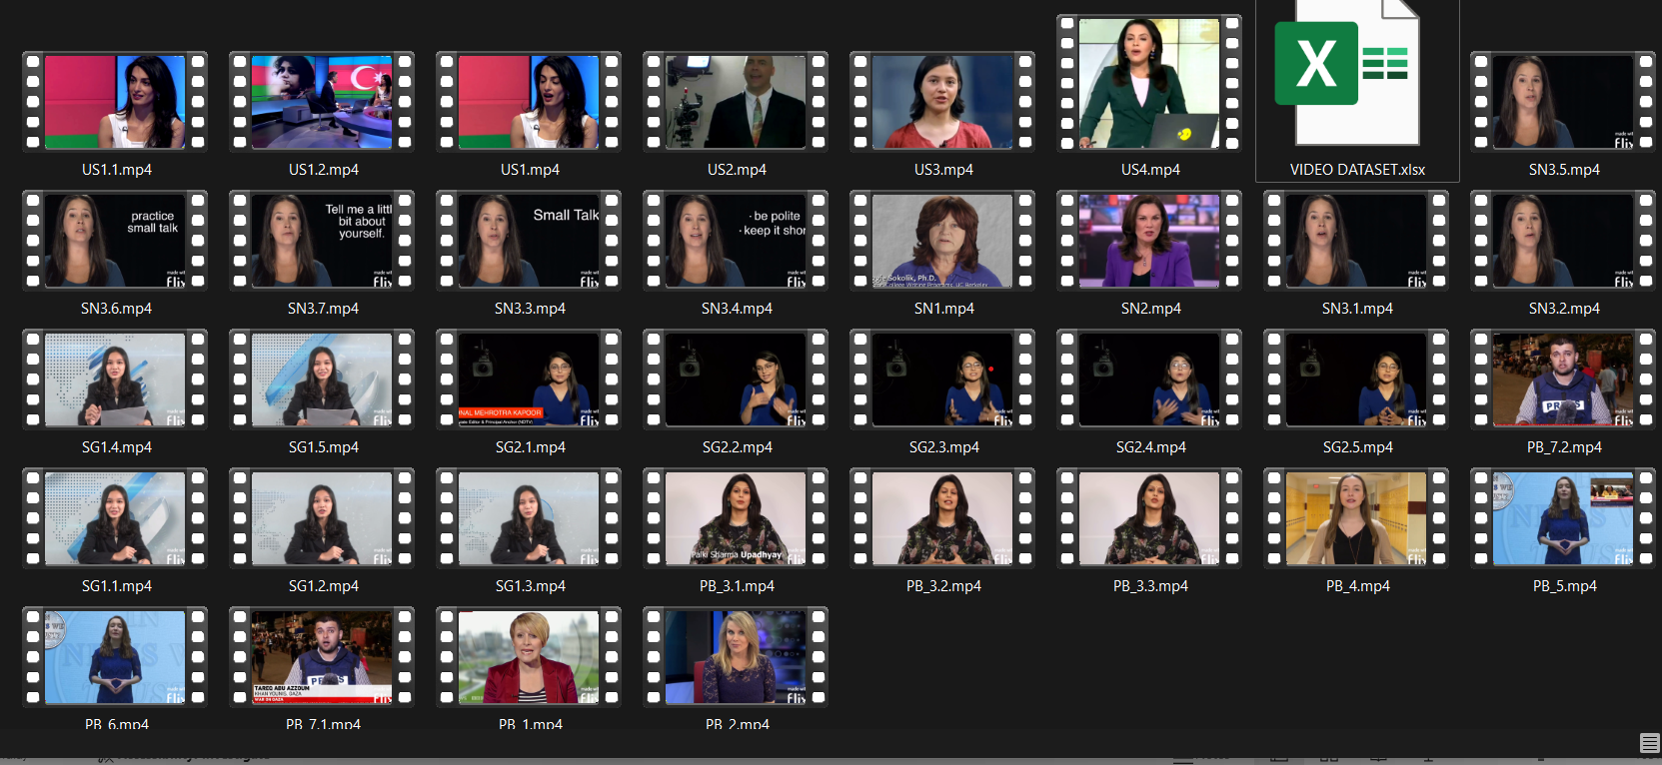
Custom Dataset

Slide 14
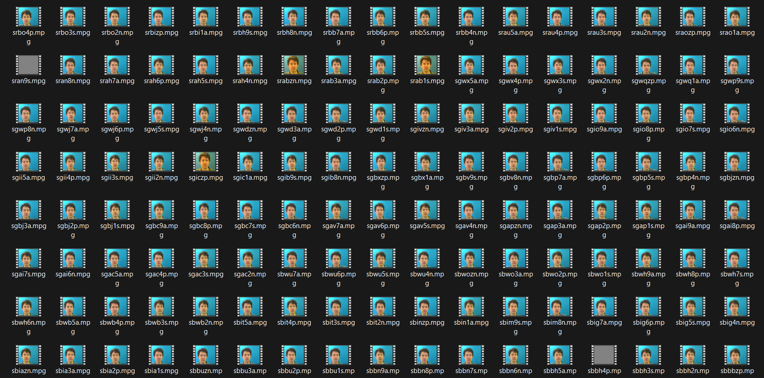
Future Scope
Due to the following problem’s we have worked on an optimized dataset which was available globally.
This is our dataset on which we have implemented our Lip Reading project.

Slide 15
Application
Emotion Recognition: Analyzing lip movements and facial expressions can contribute to emotion recognition systems, aiding in understanding emotions in human communication beyond just speech.
Human-Computer Interaction: Enables hands-free communication with devices, assisting in voice-controlled applications in noisy or quiet settings.
Forensic Analysis: Assists in analyzing videos where audio is unclear or unavailable, aiding in criminal investigations or court proceedings.
Improved Audio-Visual Technology: Enhances video conferencing or multimedia experiences by providing accurate subtitles or transcripts.
Automatic Speech Recognition (ASR) Enhancement: Automatic Speech Recognition (ASR), also known as Speech to Text (STT), is the task of transcribing a given audio to text

Slide 16

Thank You!

